Slide 1
Computer Graphics
Presented By : Mr. Madhur Thapliyal
Assistant professor
School of computing
Department of computer applications

Slide 2
Definition
Graphics are defined as any sketch or a drawing or a special network that pictorially represents some meaningful information. Computer Graphics is used where a set of images needs to be manipulated or the creation of the image in the form of pixels and is drawn on the computer. Computer Graphics can be used in digital photography, film, entertainment, electronic gadgets, and all other core technologies which are required. It is a vast subject and area in the field of computer science. Computer Graphics can be used in UI design, rendering, geometric objects, animation, and many more. In most areas, computer graphics is an abbreviation of CG.

Slide 3
Types of Computer Graphics
Raster Graphics: In raster, graphics pixels are used for an image to be drawn. It is also known as a bitmap image in which a sequence of images is into smaller pixels. Basically, a bitmap indicates a large number of pixels together.
Vector Graphics: In vector graphics, mathematical formulae are used to draw different types of shapes, lines, objects, and so on.

Slide 4
Applications
Computer Graphics are used for an aided design for engineering and architectural system- These are used in electrical automobiles, electro-mechanical, mechanical, electronic devices. For example gears and bolts.
Computer Art – MS Paint.
Presentation Graphics – It is used to summarize financial statistical scientific or economic data. For example- Bar chart, Line chart.
Entertainment- It is used in motion pictures, music videos, television gaming.
Education and training- It is used to understand the operations of complex systems. It is also used for specialized system such for framing for captains, pilots and so on.
Visualization- To study trends and patterns. For example- Analyzing satellite photo of earth.

Slide 5
Graphics Hardware(Keyboard, Printers , plotters etc)
Graphic Cards The most important piece of graphics hardware is the graphics card, which is the piece of equipment that renders out all images and sends them to a display. There are two types of graphics cards: integrated and dedicated. An integrated graphics card, usually by Intel to use in their computers, is bound to the motherboard and shares RAM(Random Access Memory) with the CPU, reducing the total amount of RAM available. This is undesirable for running programs and applications that use a large amount of video memory. A dedicated graphics card has its own RAM and Processor for generating its images, and does not slow down the computer. Dedicated graphics cards also have higher performance than integrated graphics cards. It is possible to have both dedicated and integrated graphics, however once a dedicated graphics card is installed, the integrated card will no longer function until the dedicated card is removed.
The GPU or graphics processing unit, is the unit that allows the graphics card to function. It performs a large amount of the work given to the card. The majority of video playback on a computer is controlled by the GPU.

Slide 6
Display Drivers
A display driver is a piece of software which allows your graphics hardware to communicate with your operating system. Drivers in general allow your computer to utilize parts of itself, and without them, the machine would not function. This is because usually a graphics device communicates in its own language, which is more sophisticated, and a computer communicates in its own language, which largely deals with general commands. Therefore, a driver is required to translate between the two, and convert general commands into specific commands, and vice versa, so that each of the devices can understand the instructions and results.

Slide 7
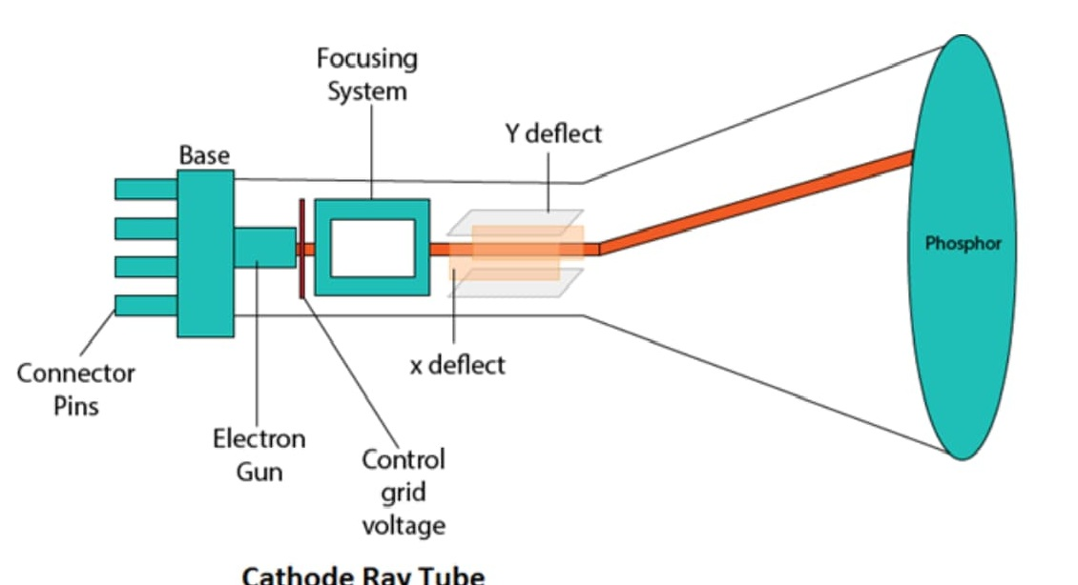

Slide 8
Two types of CRT
Raster Scan Display
Random Scan Display

Slide 9
Raster Scan Display
It is a scanning technique in which the electron beam moves along with the screen. It moves from top to bottom, covering one line at a time.
A raster is based on pixel intensity control display as a rectangular display as a rectangular box on the screen called a Raster.
Picture description is stored in the memory area called Refresh Buffer or Frame Buffer.
Frame Buffer is also called Raster or Bitmap. Raster provides the refresh rate of 60 to 80 frames per second..
Ex- Television.

Slide 10
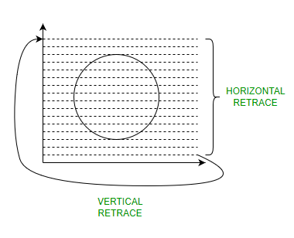

Slide 11
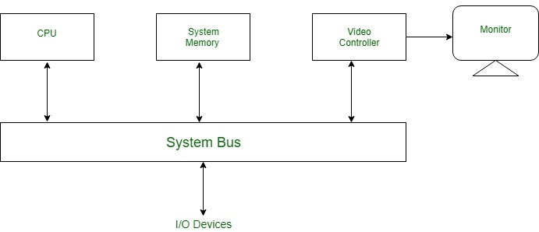
Display Processor

Slide 12
Random Scan Display
In random scan display, the electron beam is directed towards the areas of the screen where the picture has to be drawn. It is also called Vector display.
It does not contain the Frame buffer as the electron beam is directed only to the areas of the images and nothing needs to be saved.

Slide 14
Difference
Raster
High resolution
More expensive
Modification is easy
Beam Penetration technology comes under it
Random
Low Resolution
Less expensive
Modification is difficult
Shadow Mask is used under it.

